Slide 1

IT Trend 2015 to 2017
&
New Technology

Slide 2
Index
2015 IT Trend
2016 IT Trend
2017 IT trend
Conclusion

Slide 3
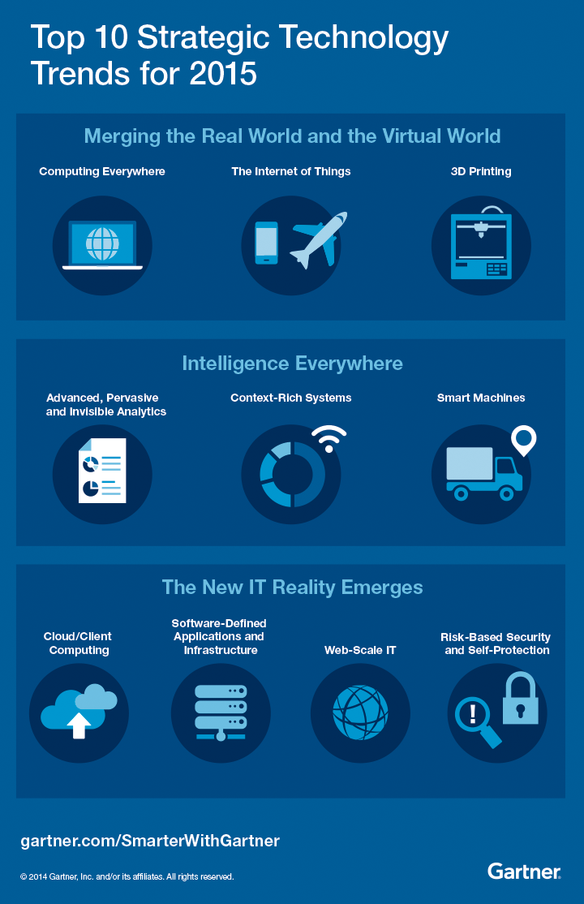
1.0 IT Trend 2015
Computing Everywhere
2. The Internet of Things
3. 3D printing
4. Advanced, Pervasive, Invisible Analytics
5. Context-Rich System
6. Smart Machines
7. Cloud / Client Architecture
8. Software-Defined Infrastructure & Applications
Web-Scale IT
10. Risk-Based Security and Self-Protection

Slide 4
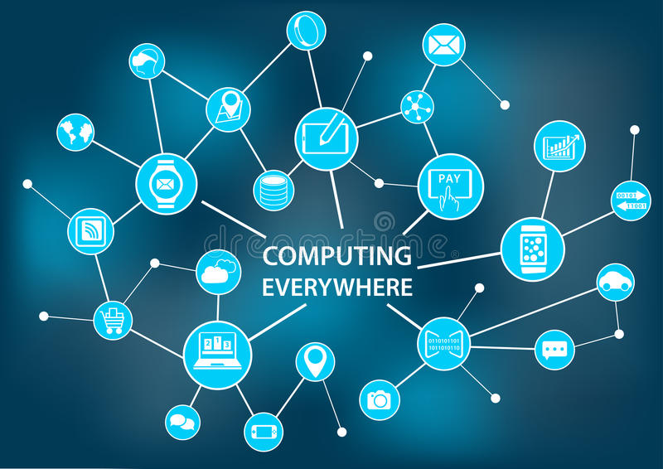
1.1 Computing Everywhere
Services that are available on all devices and platforms.
Significant demand for products and services that are available on mobile and cloud platform.
Including wearable devices, smart-phones, responsive website designs and applications etc..

Slide 5
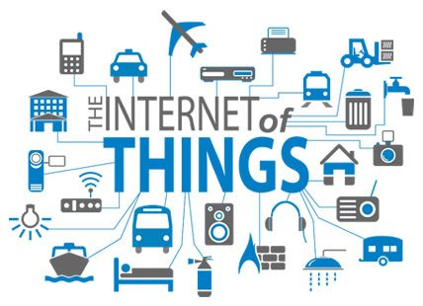
1.2 The Internet of Things
A network will be connected over 20 billion devices and create an immense amount of data that need to processing it effective
Connected devices to creep into most businesses, similar computers.

Slide 6
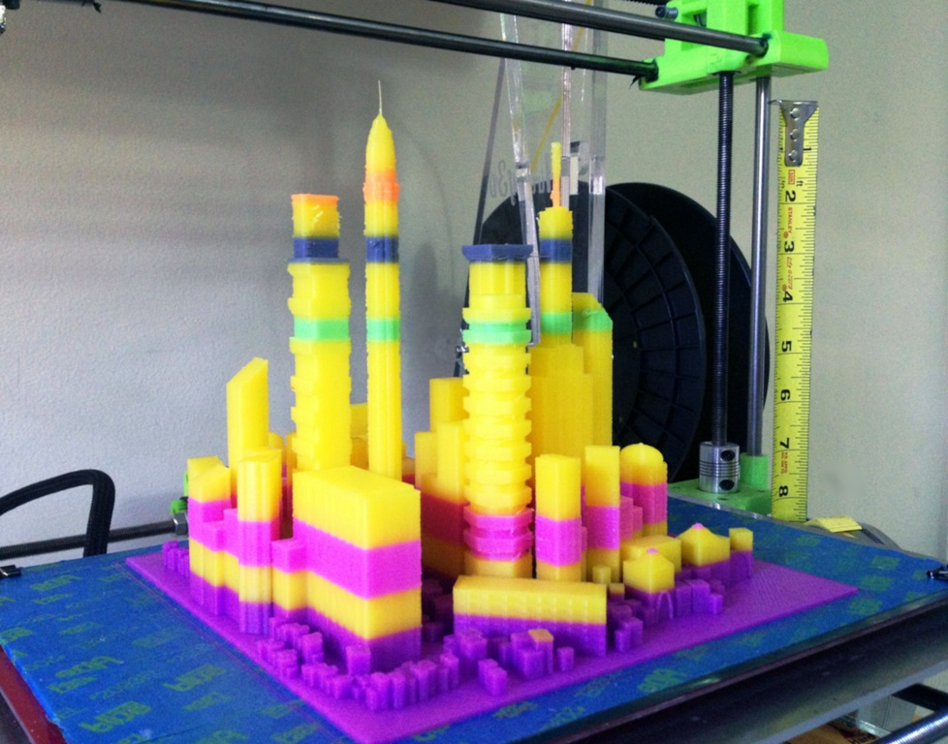
1.3 3D printing
(In 2015) The cost of 3D printing will decrease in the next three years, leading to rapid growth of the market for these low-cost machines.
(now) There are many places can use 3D printer and 3D printer is used in various industry.

Slide 7
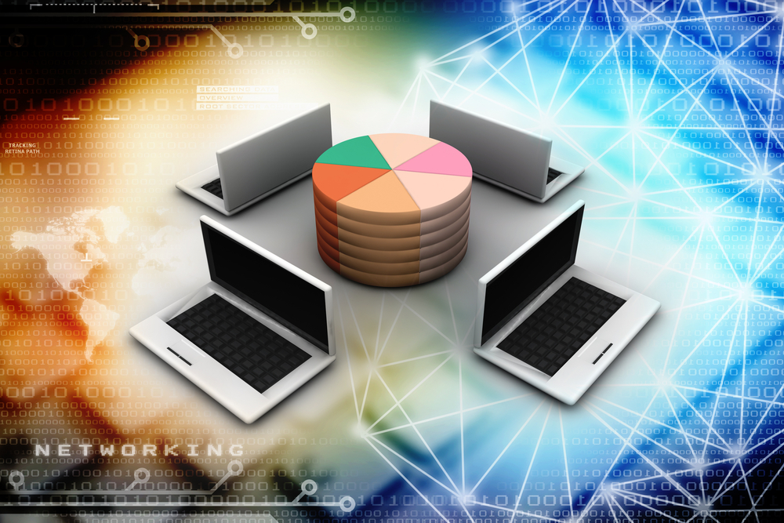
1.4 Advanced, Pervasive, Invisible Analytics
Focus is moved from big data to analysis data.
Using advanced analytics techniques such as text analytics, machine learning, predictive analytics, data mining, statistics and so on.

Slide 8
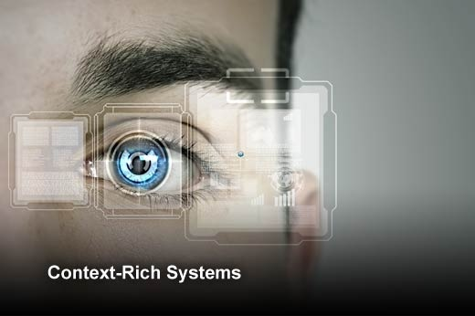
1.5 Context-Rich Systems
Context is defined as an amalgamation of data and analytics used to orient your technology while making a decision on how to perform a task.
Can used in Security, Proximate selection, auto contextual configuration, facial detection etc..

Slide 9
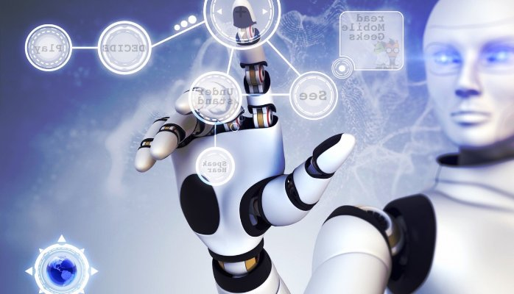
1.6 Smart machines
Advanced algorithms will lead to systems that learn for themselves and act upon those learnings.
This can lead to autonomous vehicles, advanced robots, virtual personal assistant and smart advisors.

Slide 10
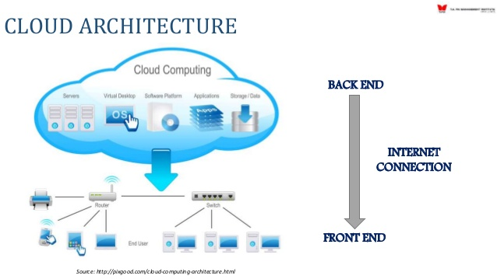
1.7 Cloud/ Client architecture
Mobile computing and cloud computing continue to converge and lead to the growth of centrally coordinated applications that can be delivered to any device.

Slide 11
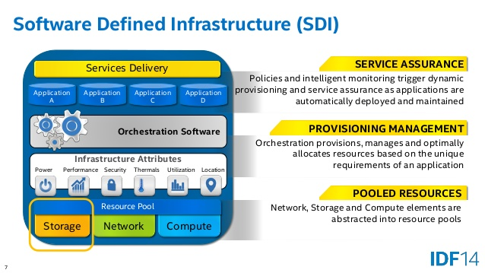
1.8 Software-Defined Infrastructure
& Applications
Software-defined infrastructure (SDI) is the definition of technical computing infrastructure entirely under the control of software with no operator or human intervention.
Typical deployments require SDN and Cloud capabilities as a minimal point of entry.
Software-defined networking ( SDN ) technology is an approach to computer networking that allows network administrators to programmatically initialize, control, change, and manage network behavior dynamically via open interfaces and provide abstraction of lower-level functionality.

Slide 12
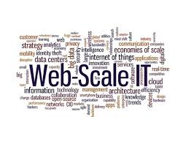
1.9 Web-Scale IT
Web-scale IT, like large cloud service providers like Amazon, Google, and Facebook, builds data centers and runs the cloud to deliver their Internet services faster and faster.
Web-oriented architecture helps developers build fault tolerance faster, flexible and resilient systems.

Slide 13
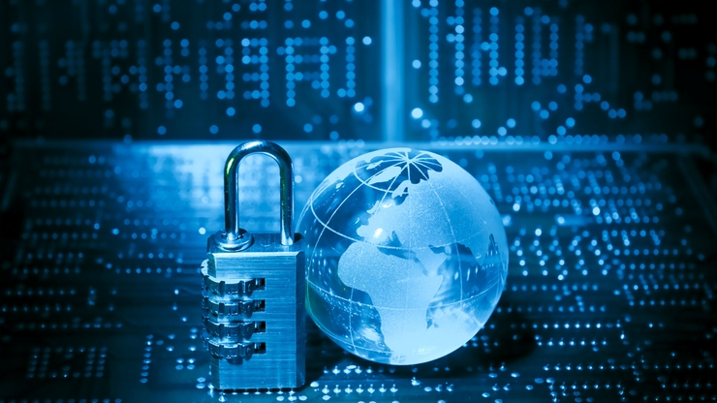
1.10 Risk-Based Security &
Self-Protection
Risk-based security and self-defense represent more sophisticated risk assessment and mitigation tools and a variety of active security technologies.
Security can be loaded into apps, networks, devices, and more.
The level of security applied depends on the functionality and cost.

Slide 14
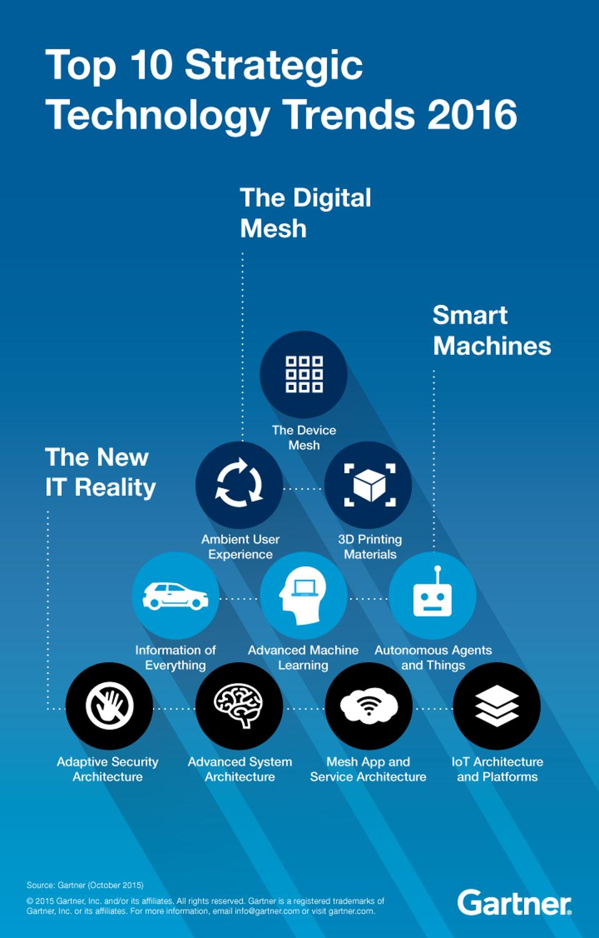
2.0 IT Trend 2016
The Device Mesh
Ambient User Experience
3D-Printing Materials
Information of Everything
Advanced Machine Learning
Autonomous Agent and Things
Adaptive Security Architecture
Advanced System Architecture
Mesh App and Service Architecture
Internet of Things Architecture and Platforms

Slide 15
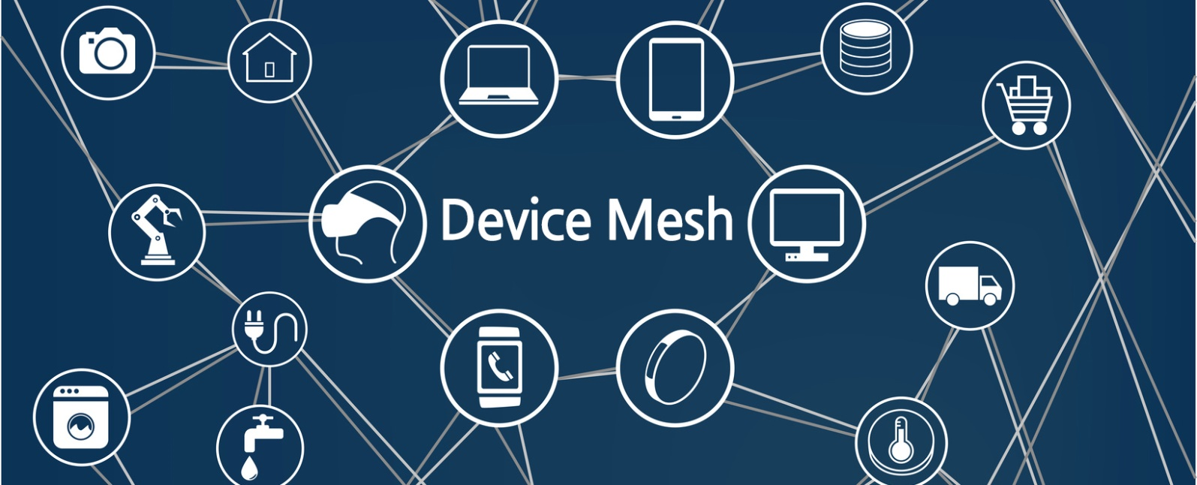
2.1 The Device Mesh
Mesh means that several devices are closely connected like a mesh.
'Connection’ becomes important as the compatibility between devices is increased rather than using an independent device.
Humans become passive and devices become active.
Wearable & virtual industry will go up. ( ex. Mercedes-Benz with Nest)

Slide 16
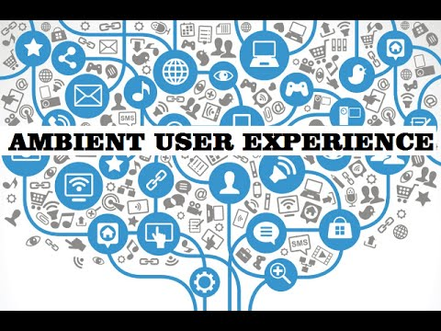
2.2 Ambient User Experience
It connects to the context as well as to the device connection.
Understand the context and connect other devices that people want.

Slide 17
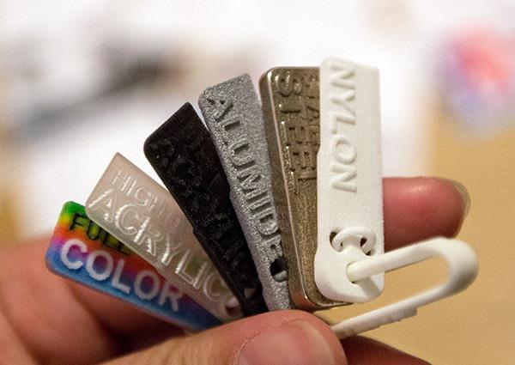
2.3 3D-printing Materials

Slide 18
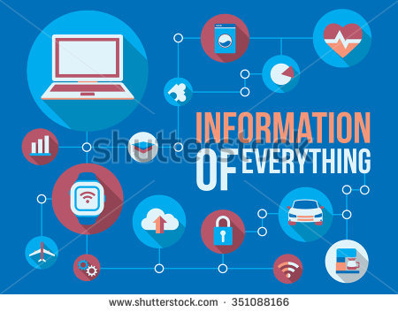
2.4 Information of Everything
Everything surrounding us in the digital mesh is producing, using and communicating with virtually unmeasurable amounts of information.
Organizations must learn how to identify what information provides strategic value, how to access data from different sources, and explore how algorithms leverage Information of Everything to fuel new business designs.

Slide 19
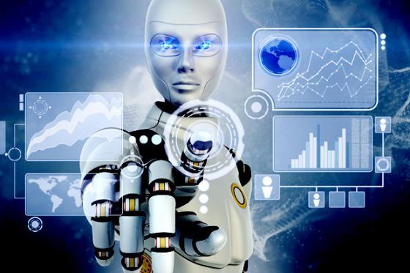
2.5 Advanced Machine Learning
Use deep neural network.
Analysis data and extract Pattern.

Slide 20
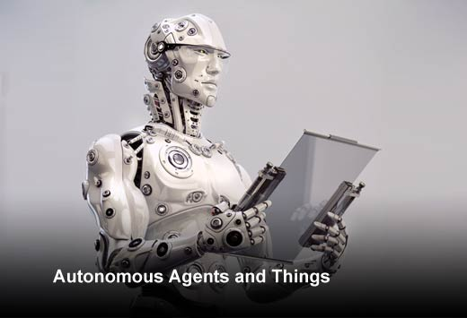
2.6 Autonomous Agents & Things
Advanced machine learning gives rise to a spectrum of smart machine implementations — including robots, autonomous vehicles, virtual personal assistants (VPAs) and smart advisors — that act in an autonomous (or at least semiautonomous) manner.
This feeds into the ambient user experience in which an autonomous agent becomes the main user interface. Instead of interacting with menus, forms and buttons on a smartphone, the user speaks to an app, which is really an intelligent agent.

Slide 21
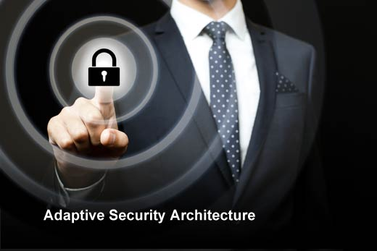
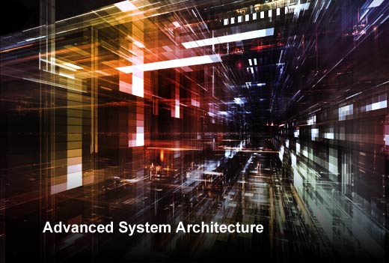
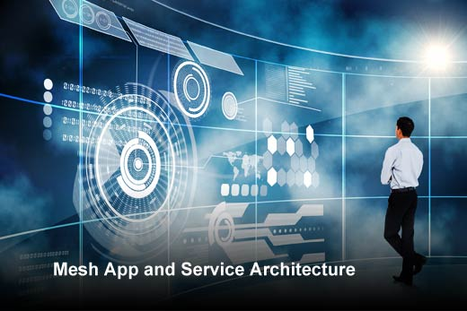
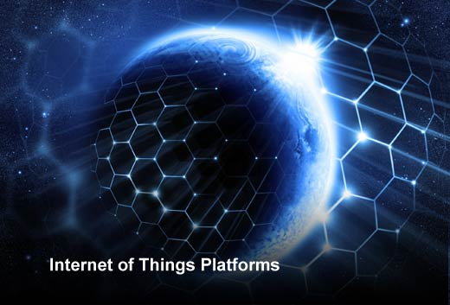
2.7 ~ 2.10 The New IT Reality

Slide 22

2.7 ~ 2.10 The New IT Reality
These 4 Strategies are means that we have to think Infrastructure again.
“ Human can no longer find security weakness perfectly.
Infra itself find security weakness and gives alarm to human. “

Slide 23
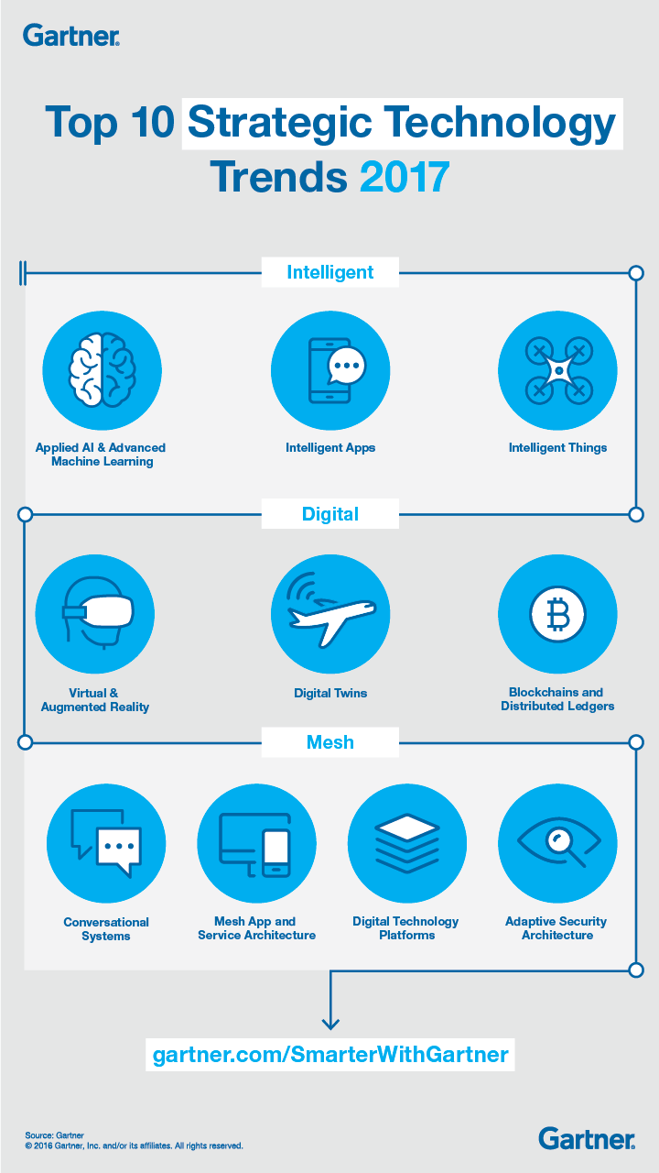
3.0 IT Trend 2017
AL & Advanced Machine Learning
Intelligent Apps
Intelligent Things
Virtual & Augmented Reality
Digital Twin
Block Chain
Conversational Systems
Mesh App and Service Architecture
Digital Technology platforms
Adaptive Security Architecture

Slide 24
Conclusion
Security always in need.
Intelligent is emphasized.
It takes 2 to 3 years to technology sneak into real life.
There are no big changing issue.

Slide 25
Reference
http://mic123.tistory.com/4
https://www.dreamstime.com/stock-illustration-computing-everywhere-concept-as-illustration-digital-disruption-disruptive-business-ideas-like-analytics-smart-machines-cloud-image59047028#
https://www.forbes.com/sites/peterhigh/2014/10/07/gartner-top-10-strategic-it-trends-for-2015/#7c6c526a643e
https://www.forbes.com/sites/gartnergroup/2016/01/15/top-10-technology-trends-for-2016/#1d7677082655
http://www.gartner.com/smarterwithgartner/gartners-top-10-technology-trends-2017/
https://mmta.co.uk/2016/11/15/the-internet-of-things-a-connected-world/
https://airwolf3d.com/2013/03/03/5-tips-for-3d-printing-large-models/
https://www.conres.com/it-products-solutions/news-events/top-10-technology-trends-2015-series-advanced-pervasive-invisible-analytics/

Slide 26
Reference
https://sites.google.com/site/contextrichsystemswiki/
https://www.linkedin.com/pulse/smart-machines-jetsons-macalister-bali-mba
https://www.slideshare.net/LarryCover/software-defined-storage-open-framework-and-intel-architecture-technologies
http://www.wegroup.co.th/2015/05/07/4trend/
http://blog.lgcns.com/993
https://www.youtube.com/watch?v=41duWm-z39A
http://www.3ders.org/articles/20151021-3d-printing-materials-market-set-to-overtake-the-3d-printer-market.html
http://www.decdeg.com/news-n-trend/ai-dan-advanced-machine-learning-will-spread-world-technology/
http://www.itbusinessedge.com/slideshows/top-10-strategic-technology-trends-for-2016-07.html
http://www.gartner.com/smarterwithgartner/gartners-top-10-technology-trends-2017/

Slide 27
Thank you

